Slide 1
Work Teams and Groups

Slide 2
Work Teams
A group is two or more individuals, interacting and interdependent, who have come together to achieve particular objectives
A team is a group composed of members with complementary skills who hold themselves mutually accountable for common goals and performance
LECTURE 8: Work Teams ∙ Team Formation ∙ Effectiveness
Notes:
1

Slide 3
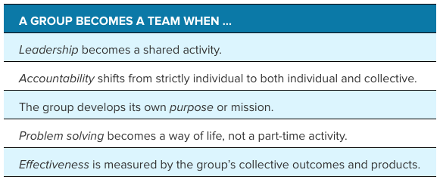
Work Teams
LECTURE 8: Work Teams ∙ Team Formation ∙ Effectiveness

Slide 4
Work Teams
There are two foundational social processes that maintain team functioning
The first are norms, which are attitudes, opinions, feelings, or action patterns that are shared by two or more people, and guide behavior
Norms are a force for conformity and stability; they can be simple (e.g., meeting times) or complex (e.g., maintaining social cohesion)
LECTURE 8: Work Teams ∙ Team Formation ∙ Effectiveness
Notes:
A sample norm would be the time Google employees are allowed to spend on non-formal projects (around 20% of their time), as well as the “15 percent time” that 3M employees are allowed to take current project and think of innovative new offshoots, or think of new and innovative ideas from scratch.
1

Slide 5
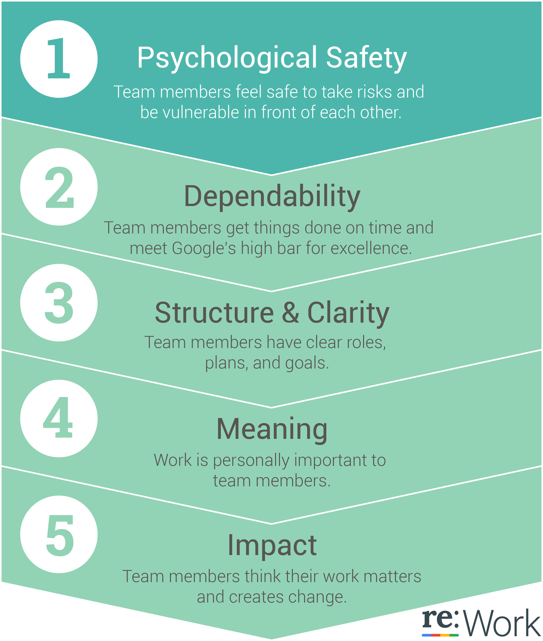
EXAMPLE
Google conducted two years of research and over 200 interviews and identified some key characteristics of their effective teams
Some are norms, others are developed by norms
LECTURE 8: Work Teams ∙ Team Formation ∙ Effectiveness
Notes:
1

Slide 6
Work Teams
The next foundational process is the development and ongoing shifting (when needed) of roles
Roles are a set of expected behaviors for a particular position (or group as a whole); roles are often perceived and are intertwined, which makes them flexible depending on the situation
Broadly, roles tend to be either task-based or maintenance-based
LECTURE 8: Work Teams ∙ Team Formation ∙ Effectiveness
Notes:
1

Slide 7
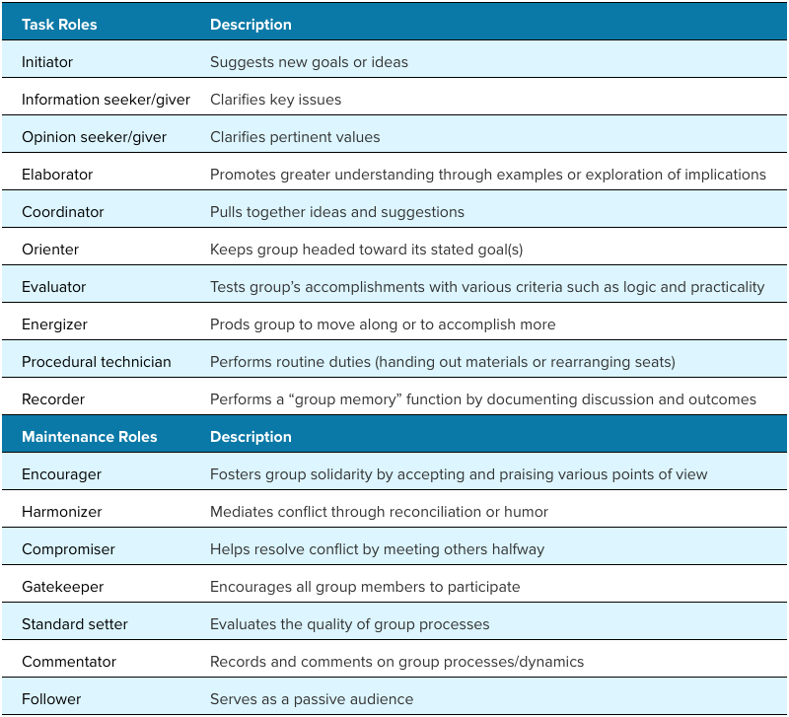
LECTURE 8: Work Teams ∙ Team Formation ∙ Effectiveness
Notes:
1

Slide 8
Team Formation
Groups and teams form through a number of phases as they resolve ambiguity in these issues and develop norms and roles to guide them:
Interpersonal: trust, personal comfort, security
Task: mission/purpose of group, methods, outcomes expected
Authority; assigning leadership, determining how power is managed.
LECTURE 8: Work Teams ∙ Team Formation ∙ Effectiveness

Slide 9
Team Formation
Once triggered, formally or informally, there are five stages of group formation:
Forming: Undefined roles makes people dependent on a leader or initial goals
Storming: People evaluate each other, conflict, and compete for roles/positions
Norming: Roles/responsibilities become clear and consensually accepted
Performing: Focus on goal attainment, adaptive and self-correcting
Adjourning: Team members move on
LECTURE 8: Work Teams ∙ Team Formation ∙ Effectiveness

Slide 10
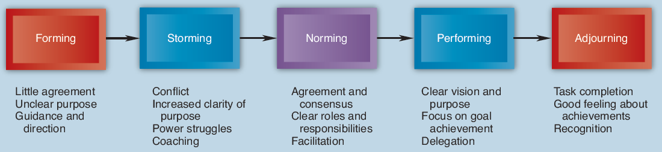
Team Formation
LECTURE 8: Work Teams ∙ Team Formation ∙ Effectiveness

Slide 11
Team Formation
The five-stage model is a useful framework, yet team formation does not always occur linearly
The punctuated equilibrium model finds that groups will spend large periods of time at one stage, and then experience certain key events that rapidly accelerate development before settling on a new baseline group behavior
LECTURE 8: Work Teams ∙ Team Formation ∙ Effectiveness

Slide 12
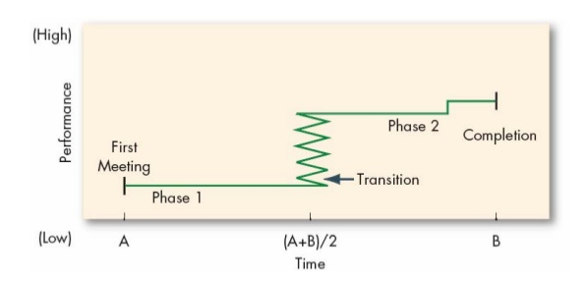
Team Formation
LECTURE 8: Work Teams ∙ Team Formation ∙ Effectiveness

Slide 13
Team Effectiveness
As a team travels through the stages of formation, effective management of roles and norms can build team cohesion, which is attraction among members and a motivation to stay in the team
Cohesion can enhance engagement and team performance, what factors affect cohesion?
Small group size, consensous on goals , interaction frequency, status, difficulty to join, intergroup competition, group-based rewards, distance
LECTURE 8: Work Teams ∙ Team Formation ∙ Effectiveness
Notes:
1

Slide 14
Team Effectiveness
A primary threat to cohesion is social loafing, which is the tendency for individual effort to decline as group size increases; how can we reduce the chance of social loafing?
Set group goals (gives common purpose), peer evaluations, allows members autonomy in deciding their roles, identifying/rewarding individuals’ input into a group
LECTURE 8: Work Teams ∙ Team Formation ∙ Effectiveness
Notes:
<number>

Slide 15
Team Effectiveness
Please review the Virtual Teams section on your own again
LECTURE 8: Work Teams ∙ Team Formation ∙ Effectiveness
Notes:
<number>

